Slide 1


Department of Computer Science &Engineering Artificial Intelligence & Machine Learning
A.P. Shah Institute of Technology
G.B.Road, Kasarvadavli, Thane(W), Mumbai-400615
UNIVERSITY OF MUMBAI
Academic Year 2023-2024

Slide 2

CORPORATE TRADING PORTFOLIO MANAGEMENT SYSTEM
BY
AAFREEN KHAN (22106048)
PRACHITI PARAB (22106028)
SNEHA GUPTA (22106046)
PRPOJECT GUIDE
PROF. VIJAYA BHARATHI JAGAN

Slide 3

Outline
Introduction
Literature survey of existing system
Limitation of existing system
Problem Statement
System Design
Technology and methodologies
Implementation
Conclusion
References

Slide 4

Introduction
1
Import/export industry is crucial for global commerce, facilitate movement of good across border
2
Challenges in logistics, finance and operations management
3
Highlighting the issues faced in managing a growing workforce effectively.

Slide 5

Introduction
1
This system include features like -Employee onboarding, Attendance tracking, Orders record, Leave management
2
Develop an well designed site to store employee information
3
An easy way to automate all functionality of employee of company

Slide 6
Literature Survey
Sr. No. | Title of Paper | Name of Authors, and Date of publication | Description
1 2 3 | “Web Based Staff management system" March(2017) “Challenges of implementing an employee management system for improving workplace management" "Employee Management system" | Sayali Pramod Dalke , Shruti Anil Deshmukh, Janabai Govind Dalave, Vaishnavi Nitin Sasane, Pooja K Dhule March(2017) Prety Diawati, Politeknik Pos Indonesia,(2019) P. U.Singh , H.Singh Fartyal, Abdul Zubair(2019) | Uses the ordinary classical methods which are merely based on pen-paper to record the data of their employees The employee management system is designed for saving money time and power. Uses HTML, CSS and PHP as technologies and proposed to develop features such as employee profiles and, leave and task management.
"Web Based Staff management system" March(2017)
"Managing Personnel Records in Electronic Environment" (2009)
"Employee Management system"(2019)
-Uses the ordinary classical methods which are merely based on pen-paper to record the data of their employees
-Require an external device to be installed in the working area..
-Uses HTML, CSS and PHP as technologies and proposed to develop features such as employee profiles and, leave a

Slide 7

Limitation of Existing System
Manual Effort Required
Limited Employee Visibility
Data Security Concerns
Accuracy and Data Integrity Issues
Time-Consuming Processes

Slide 8
Problem Statement
Designing a software solution to efficiently manage all aspects of employee data along user login, including personal information, order details, customer details, editor for keeping track of personal notes and kanban.

Slide 9
System Design
1
Architecture
Client-Server Architecture, Choose appropriate databases, Develop frontend and backend components.
2
Modules
Employee onboarding, Attendance tracking, Punch in- Punch out, Leave management, Orders management.
3
Functionality
Employee management, reporting.

Slide 10
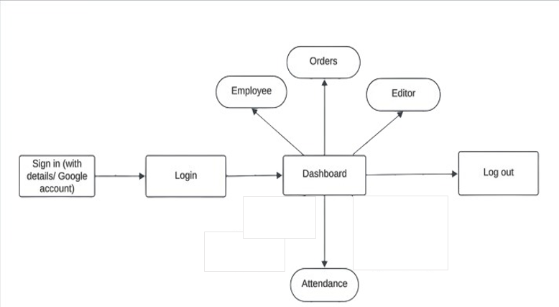
System Design

Slide 11
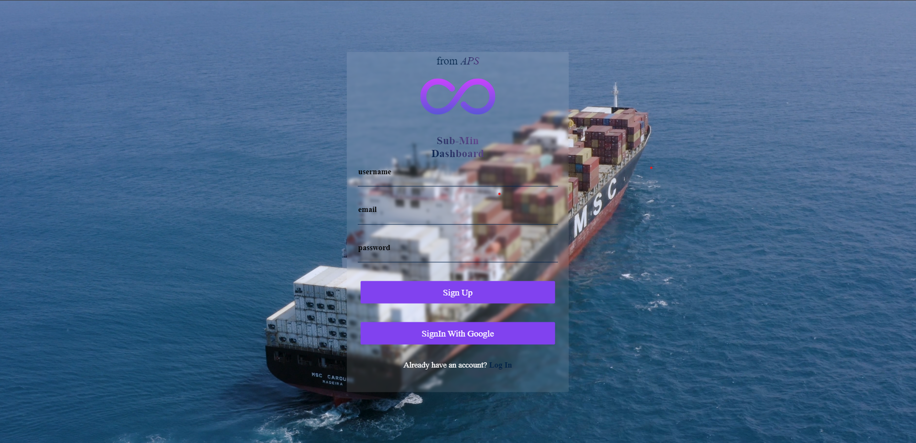
Implementation

Slide 12
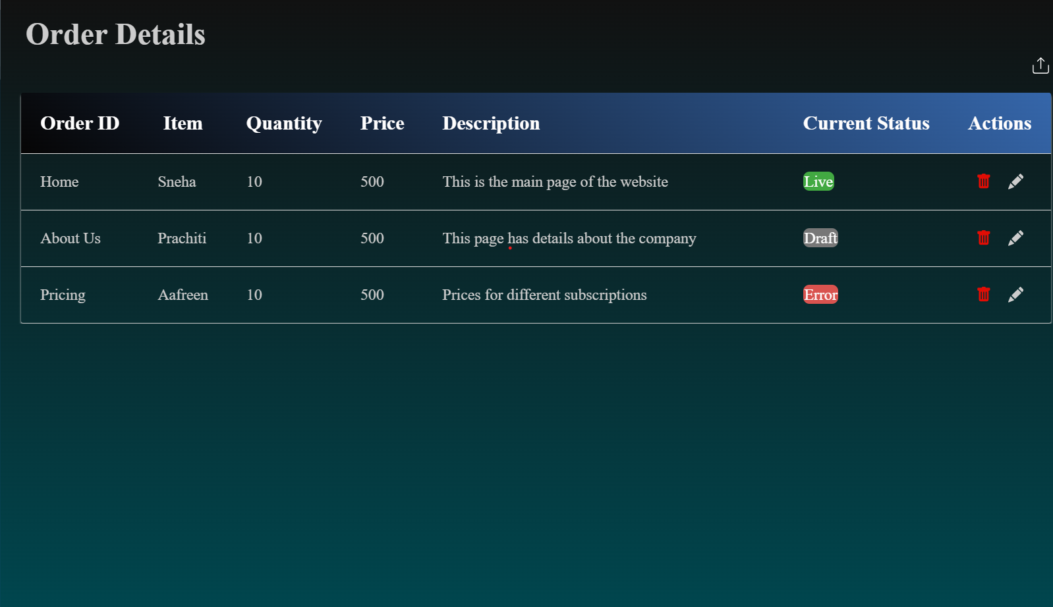

Slide 13
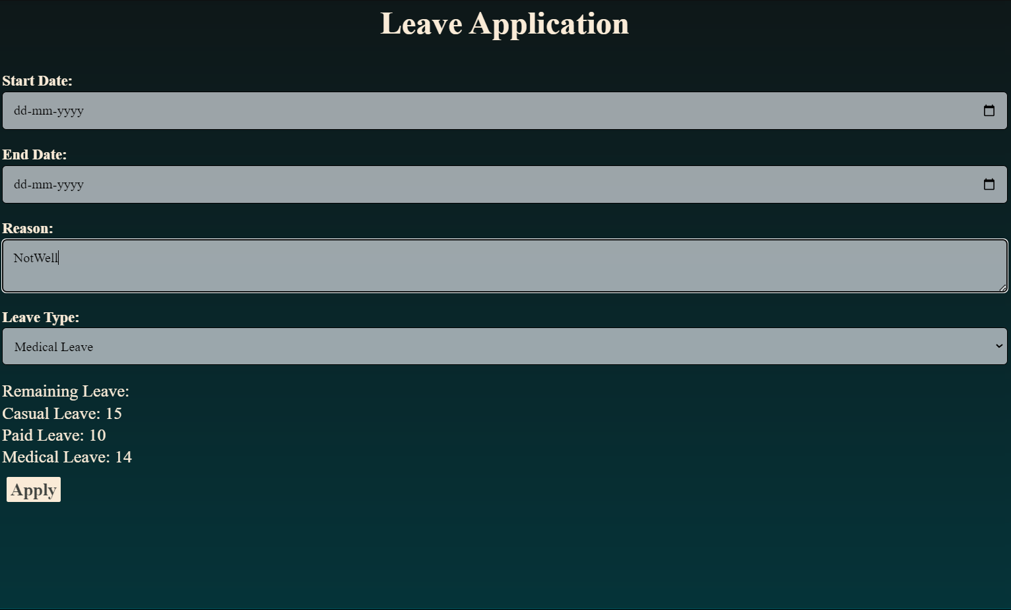

Slide 14
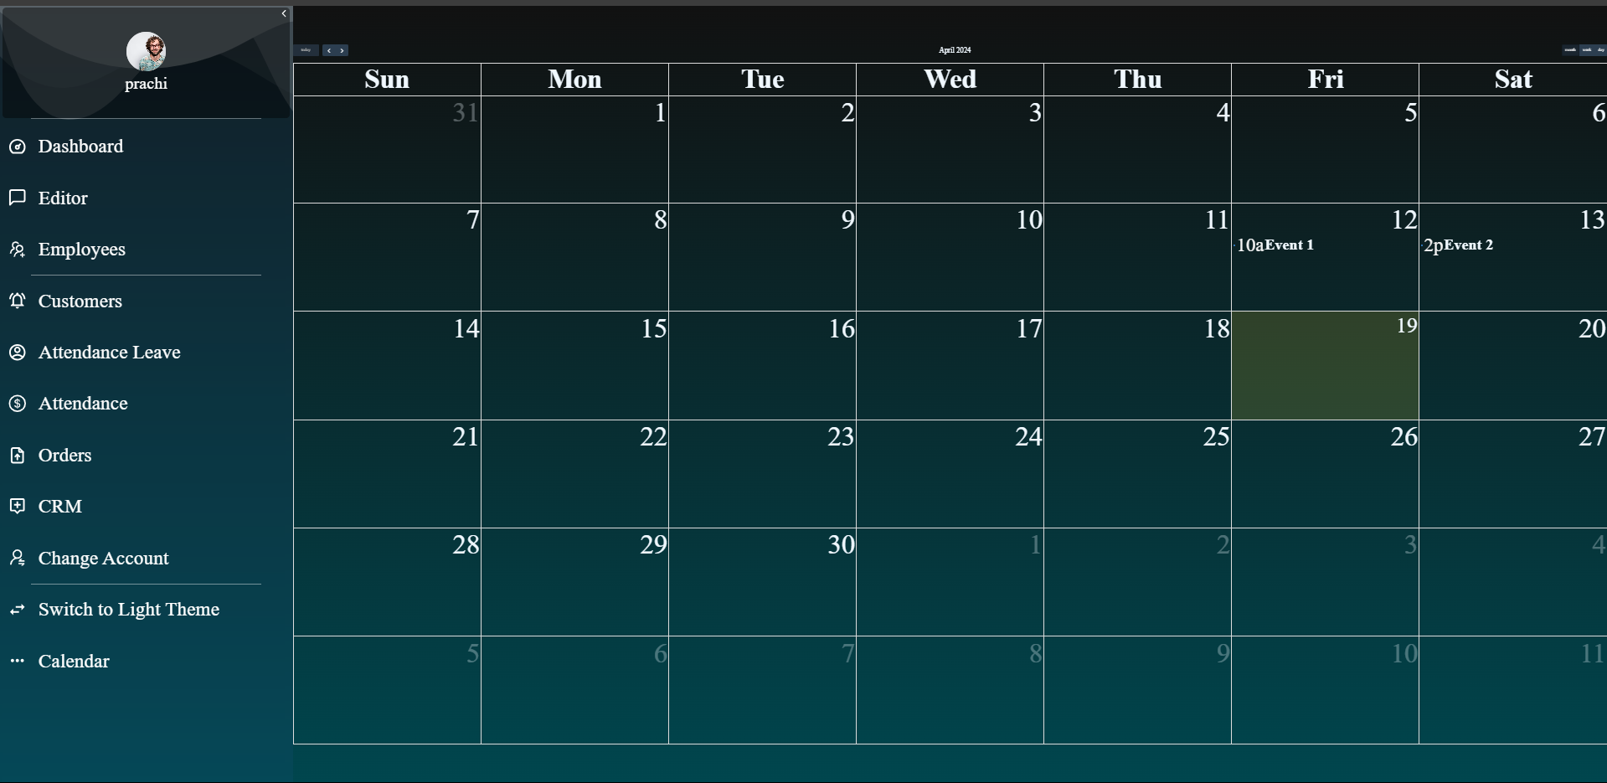

Slide 15



Tools/Softwares, Languages Used
ReactJs
Visual studio code
Github

Slide 16



Tools/ Softwares, Languages Used
CSS
JavaScript
HTML

Slide 17



Conclusion
Our web application represents a significant leap forward in the digital transformation of import/export operations..
By addressing the logistical intricacies inherent in this industry, we empower businesses to thrive in a competitive global marketplace.

Slide 18
References
[2] Sayali Pramod Dalke, Shruti Anil Deshmukh, Janabai Govind Dalave, Vaishnavi Nitin Sasane, Pooja K Dhule, “Web Based Staff Management System”,IJSTE Vol-3, March-2017
[1] P. U. Singh, H. Singh Fartyal, K. Abdul Ahad Zubair & A. Laddha. (2019). Employee management system. International Research Journal Of Engineering And Technology (IRJET), 06(05).
[3] Griffin, A. & Hoyle, M. (2019). Managing Personnel Records in an Electronic Environment. International Records Management Trust, London, UK, pp. 1-2.

Slide 19
THANK YOU!!!

